Slide 1
OPTIMIZING MARKETING CAMPAIGNS USING CUSTOMER DATA
Group members-
Yeshwaritha Emmidi Badrinath- 11648431
Venkata Sai Rahul Unnam- 11808717
Mehraaz- 11690944
Krishna chaitanya Nelluri- 11701753
Tarun podila- 11691037

Slide 2
CONTENTS
Introduction
Data Discovery and Loading of Data
Data Preprocessing
Data Cleaning
Feature Engineering
Exploratory Data Analysis
Predictive Modeling
K-Nearest Neighbor Classifier
Random Forest Method
Cluster analysis
Conclusion
Business Insights and Recommendations
References

Slide 3
INTRODUCTION
The ‘marketing campaign’ dataset derived from the Kaggle data source (Marketing Campaign, 2020b).
The main objective of the project is to build a model that helps us in the prediction of the responses by the customers to a marketing campaign.
Understanding the customer segmentation data to understand and analyze the marketing campaign.
The analysis of the demographic features of the customer data along with the responses to the campaigning data helps in providing insights and recommendations to improve the future campaigning rate.

Slide 4
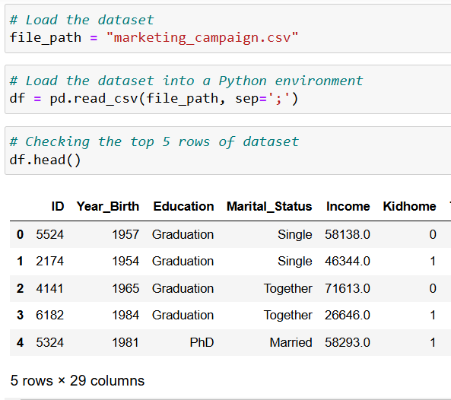
DATA DISCOVERY AND LOADING OF DATA
The marketing campaign dataset is derived from Kaggle data source.
The basic python libraries are loaded before the start of the analysis.
The dataset is loaded into the Jupyter notebook using the code pd.read_csv.
The dataset comprises of 2240 rows and 29 columns.
The variables list includes some important features like marital status of the customer, education level of the customer, yearly income of the customer, customer acceptancedata, amount spent on specific products by the customer, number of purchases made in stores and on the website, and campaign responses for the participation in the campaign.

Slide 5
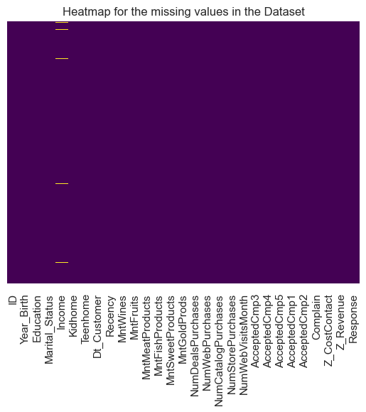
DATA PREPROCESSING
It involves data cleaning and transforming the raw data into clean and useful data ready for data analysis.
DATA CLEANING
The first step in data preprocessing is to check for any missing values using a heatmap.
The ‘Income’ column reveals missing values in it. There are about 24 missing values in the Income column.
The outliers are detected using boxplot and then removed by calculating the interquartile range- IQR.
df = df[~((df['Income'] < (Q1 - 1.5 * IQR)) | (df['Income'] > (Q3 + 1.5 * IQR)))].

Slide 6
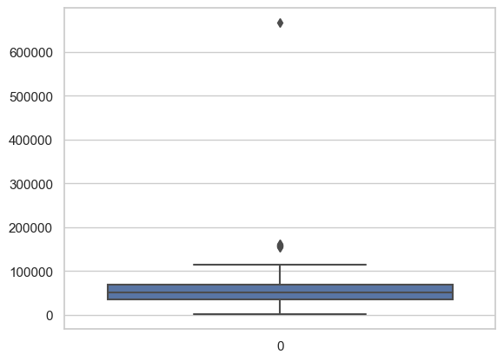
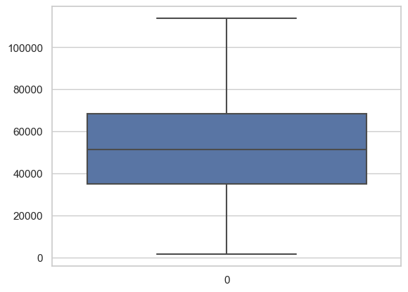
The above boxplot is plotted for the variable ‘Income’ to determine the presence of outliers in the column.
There are two outliers present in the plot.
- The above boxplot is plotted after the removal of outliers based on the Inter Quartile Range.
- We can see the absence of outliers suggesting the absence.

Slide 7
Then, we check for the presence of any duplicate rows in the dataset. The dataset has zero duplicate rows.
Next step is to identify the variables with constant values in order to drop them as they do not play a role in evaluating the model.
The columns ‘Z_CostContact’ and ‘Z_Revenue’ are the two columns with constant values and are dropped for better analysis of the dataset.
Feature engineering
This step helps in creation of new variable in the dataset that helps us in achieving the goal of the project.
The first feature that is added is creating an ‘Age’ column from ‘Year_Birth’ column.
Education column has many unique values and requires distinction.
Second feature is creating an ‘Education_Level’ column from ‘Education’ column.

Slide 8
Third feature is creating a ‘Living_Status’ column from ‘Marriage_Status’ column.
Fourth feature is creating a ‘Total_Campaigns_Accepted’ by summing the total number of campaigns accepted.
Fifth feature is creating a ‘Total spending’ column.
Sixth feature is creating a ‘Parent’ column to know whether the customer is a parent or not.
These features help in understanding the data and categorize them accordingly for better analysis.
Now there are 33 columns in the dataset.
Dropping unnecessary features- ‘Dt_Customer’, ‘Year_Birth’, and ‘ID’.

Slide 9
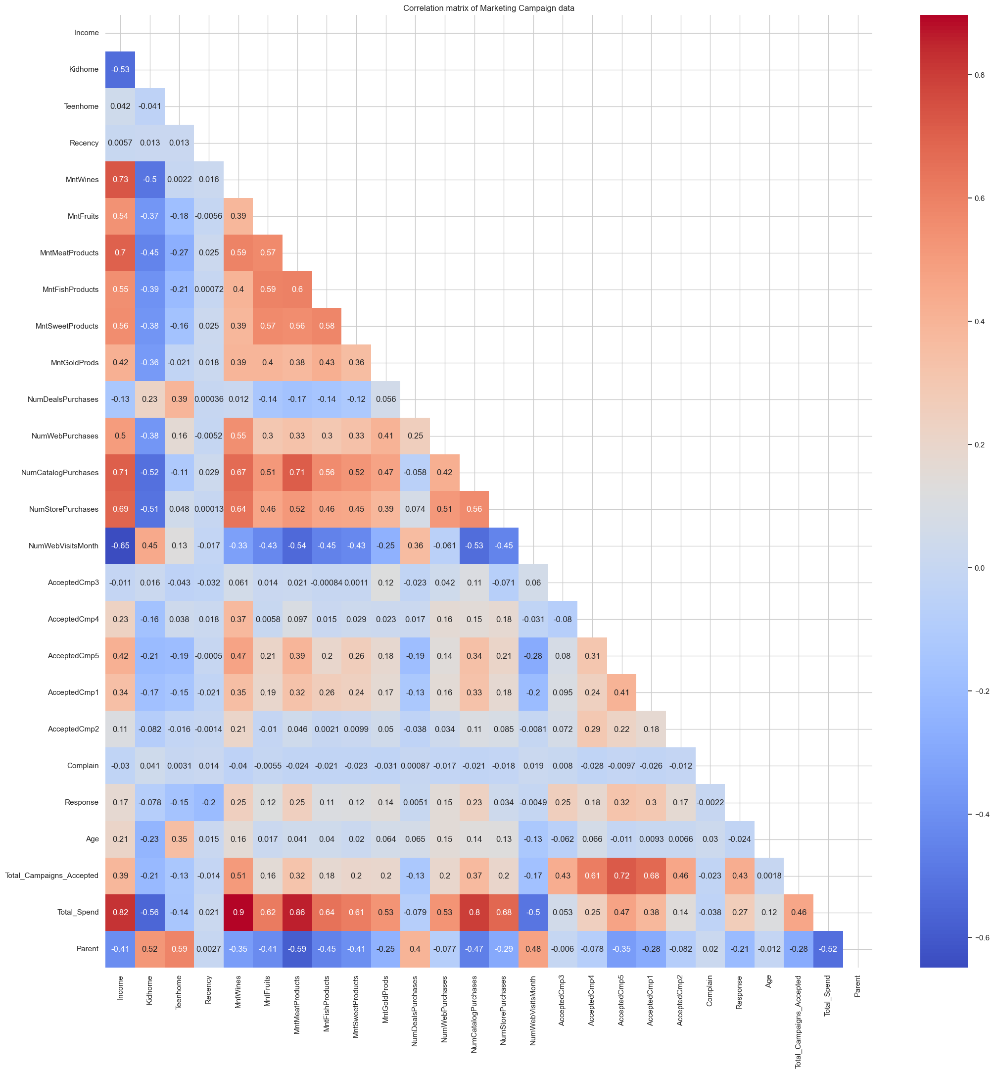
EXPLORATORY DATA ANALYSIS
Correlation matrix reveals the relationship between individual variables in the dataset.
Positive correlations-
- Strong positive correlation is seen between Total_Spend and MntWines with a value of 0.9.
- Total_Spend and MntMeatProducts: A postive correlation of about 0.86 is seen and justifies that with an increase in total spending an increase in the Mnt meat products is also seen.
Negative correlations-
- Strong negative correlation is seen between Income and NumWebVisitsMonth with a value of about -0.65.

Slide 10
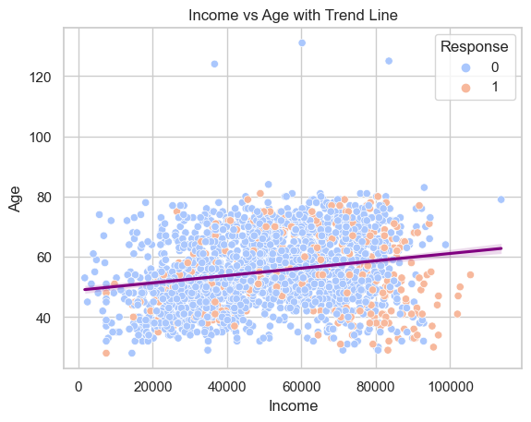
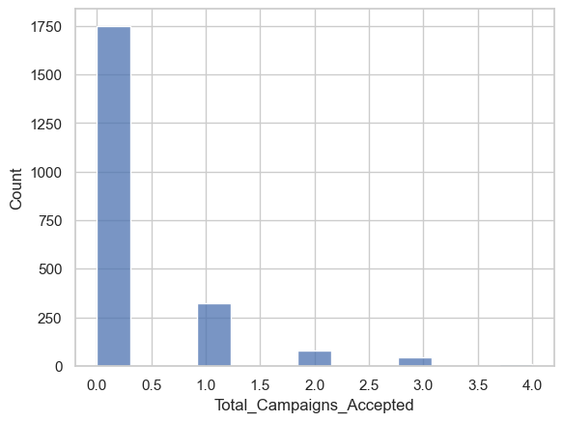
- The above scatter plot is between Income and Age variable with Response variable as hue.
- The trend line shows a slight upward slope, indicating that as Age increases, Income tends to increase as well. However, the slope is very gentle, suggesting that the relationship is weak.
- The wide spread of data points indicates that income and age are influenced by a variety of factors, and there is a lot of individual variation within each age group.
- We have 3 outliers above age 120, suggesting that it might be a very old data.
- The above bar graph is plotted to count the number of campaigns accepted by the customers.
- We can observe that the dataset have very few data on people who have accepted the campaigns.

Slide 11
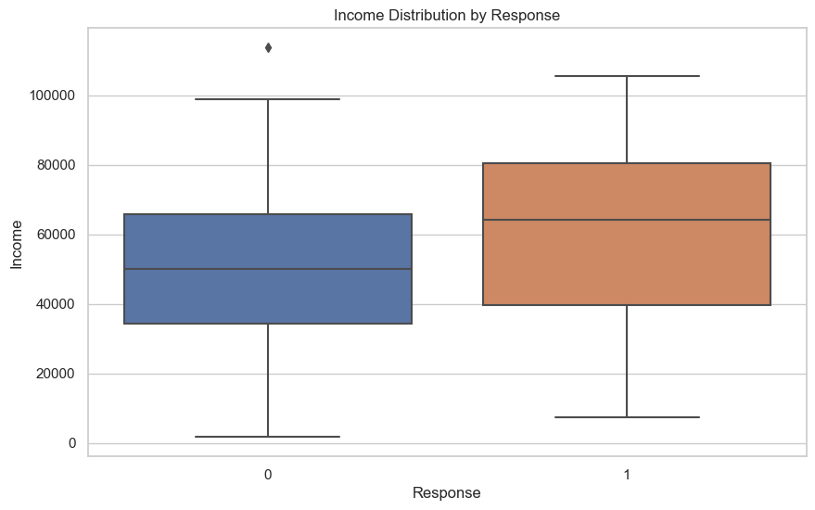
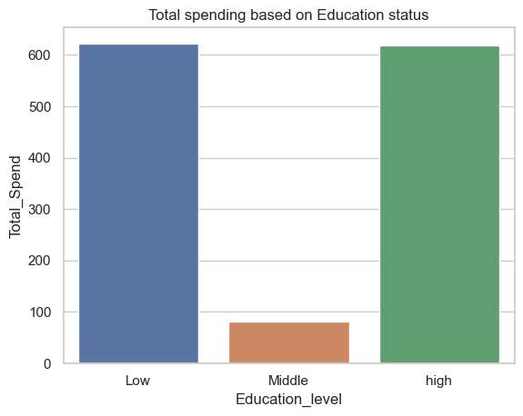
The summary statistics is calculated for all the variables in the dataset. It gives the count, mean, standard deviation, minimum, maximum, 25%, 50%, 75% values for all the numerical variables.
The above box plot is between Income and Response variables.
Customers who responded to the marketing campaign have a higher median income compared to those who did not respond.
Higher-income customers are more likely to respond to campaigns, suggesting that campaigns targeting this group could yield better results.
We can also see that People who have responded to the campaigns have a minimum income less than 40000 and maximum income of more than 100000.
- The above bar graph is between Education level and Total spend variables.
- Most of the spending is from people who have low and High education
- The middle level of education have comparatively lower expenditure on total.

Slide 12
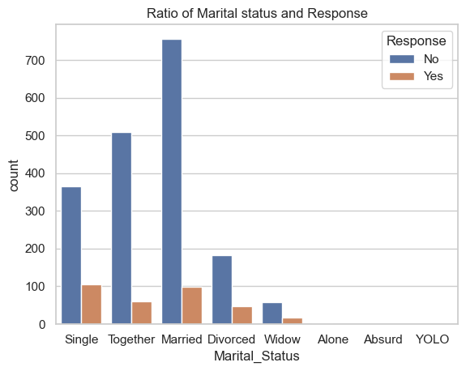
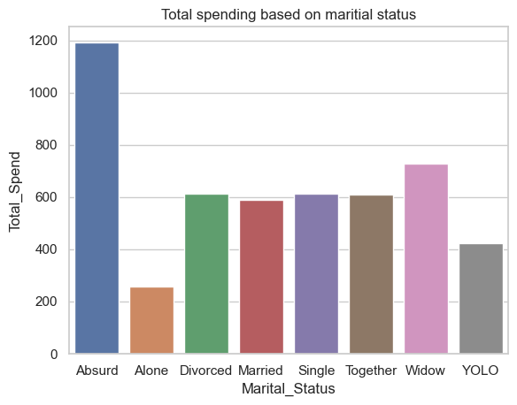
- The above plot is between the Response rate and Marital status variables.
- Married individuals: This group has the highest number of both “No” and “Yes” responses, with the “Yes” count being second highest among other groups. But since most of the married responses are “No”, It would not be as effective to target this group.
- Single individuals: This group has the highest number of “Yes” responses. By looking at the ratio of “Yes” to “No”. we can say that this is the best group to target for increase in campaign responses.
- The remaining groups have relatively low counts for “Yes” responses.
- The above bar graph is between Marital status and Total spend.
- Absurd group of people have the most spending. But we saw that they did not respond to any marketing campaign.
- So, this could be a potential group where we can put some extra efforts into, so that we would have a good response rate.

Slide 13
PREDICTIVE MODELING
The first step is to drop the columns ‘Marital Status’ and ‘Education’ as we have created a new columns specifying the variables earlier.
One hot encoding is done to encode the categorical variables- ‘Education_level’ and ‘Marital_Status’ and create dummy variables.
Standard scaler is used to execute the process of model building. Features are scaled for the variable ‘Response’ so that all the variables have similar scale to make the analysis easier.
Drop the unnecessary columns- ‘Response’ and the columns we created dummy variables.
The next step is to establish the x and y. The target variable –’y’ is determined as ‘Response’.
The test-train split is done with test size of 30 % and train size of 70% and a random state of 42.

Slide 14
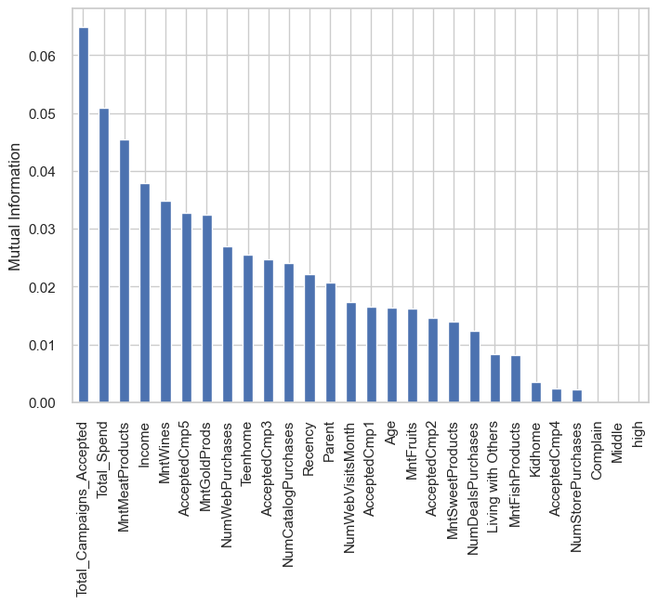
FEATURE SELECTION-
This analyzes the features of the target variable
‘Response’ using 'mutual information', 'SelectKBest' and
'random forest importance’.
This gives us a result that the top 10 features that give us a lot of information on target variable ar- 'Income’, 'Recency’, 'MntWines’, 'MntFruits’, 'MntMeatProducts’, 'MntGoldProds’, 'NumWebVisitsMonth’, 'Age’, 'Total_Campaigns_Accepted’, 'Total_Spend’.

Slide 15
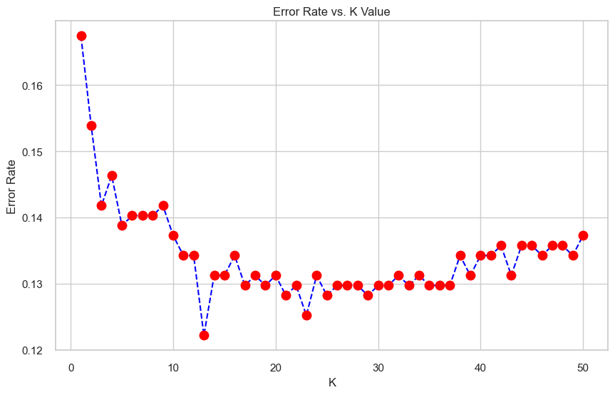
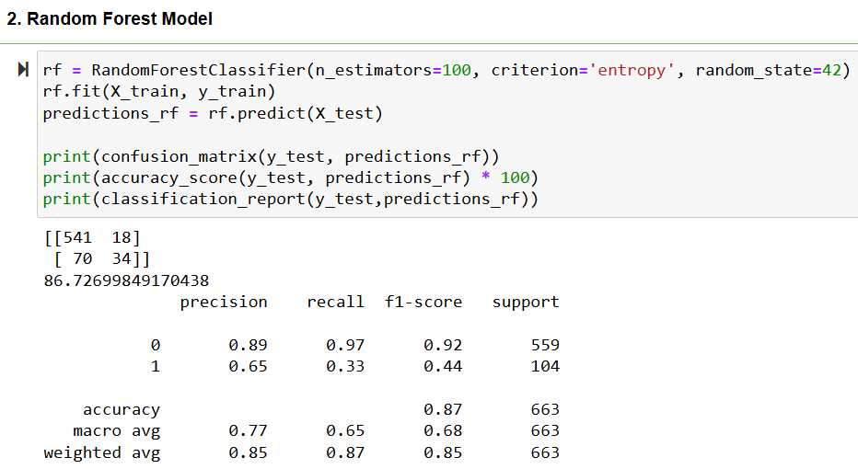
TRAINING THE MODEL
1. K-NEAREST NEIGHBOR CLASSIFIER-
- Determining the error rate for k value from 1-50 and determine the least error rate.
- The plot between ‘K’ and ‘error rate’ reveals that the error rate is least when k value is 23.
The best k value to tarin the model is determined as 23 with an accuracy score of 87.48%.
The precision value is 0.88 and 0.79 for class 0 and 1 respectively. The F 1 score is more for class 0 with a value of about 0.93.
2. RANDOM FOREST METHOD-
On evaluating the model using random forest method, we gain an accuracy of 86.72%.
The f1 score of class 0 is higher when compared to class 1 with a value of 92%.
Since the objective of prediction model is, to predict if the customer will respond to a campaign. The best model to select is Random forest model.

Slide 16
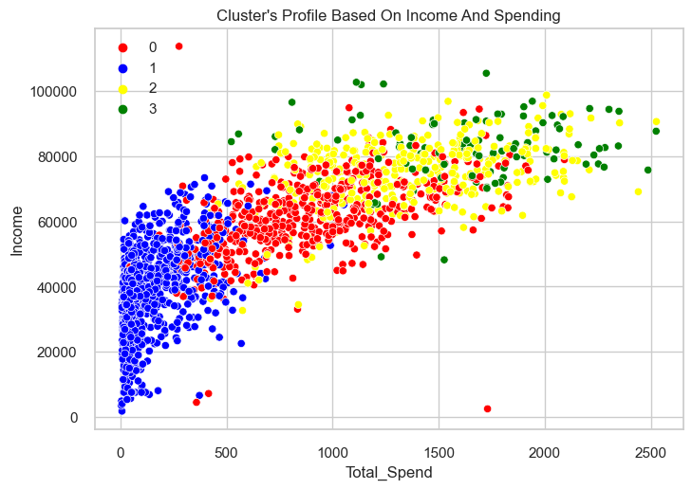
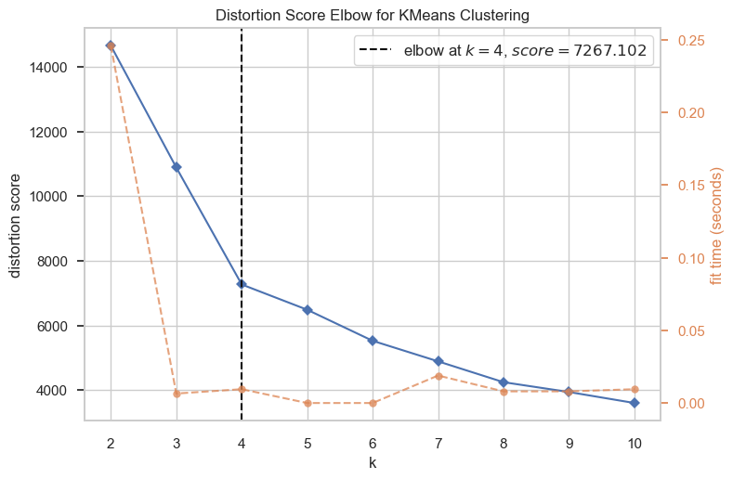
3. CLUSTER ANALYSIS-
The above scatter plot is between ‘Total Spend’ and Income to determine clustering profile.
Cluster 0 (Red): This cluster shows a wide range of income levels where majority of individuals have lower spending compared to their income level.
Cluster 1 (Blue): This cluster appears to have individuals with low to moderate income and have a low spending compared to the other clusters.
Cluster 2 (Yellow): This contains individuals with a moderate range of income levels and moderate spending levels.
Cluster 3 (Green): This cluster appears to have individuals with higher income levels and higher spending levels comparatively.
Elbow method is used to determine the number of clusters for the k mean clustering (Saji,2024).
The plot reveals that the elbow point is at 4 because that is the point where the distortion rate starts.
Hence, from the above plot we can analyze that number of optimal clusters is 4 which indicates better cluster quality.
K=4

Slide 17
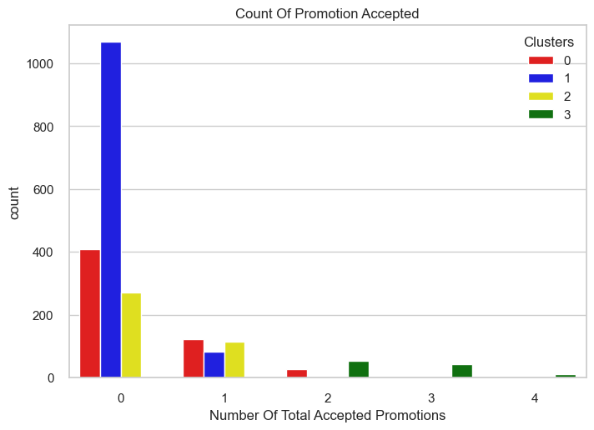
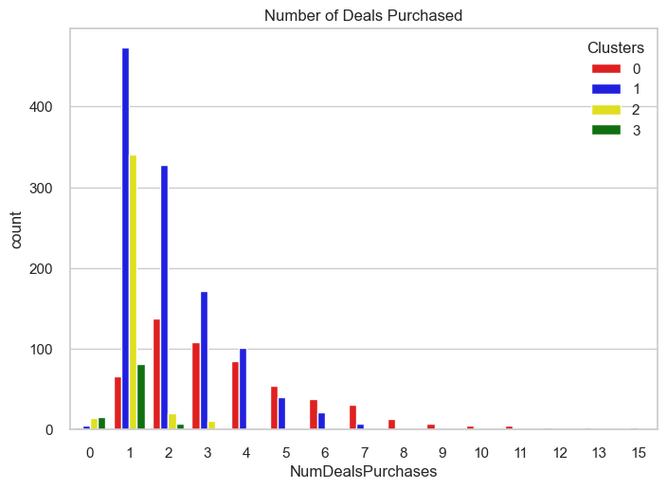
The grouped bar graph is plotted to analyze the cluster count for the variable ‘Total_Campaigns_Accepted’.
Group 3 are accepting a good number of promotions. So, increasing promotions in this category could attract more responses to the campaigns.
Group 0 are responding to promotions, though not in high quantity but improving the promotions could increase their response rate too.
Group 1 and 2 have accepted some promotions but not as significant as other Groups.
The grouped bar graph reveals the count of clusters in determining the number of deals purchased.
Group 0 and 1 are highly interested in deals and offers even though they are not responding to the promotions. Therefore, offering a better deal/offer could attract them more.
Group 2 and 3 are spending and responding irrespective of deals. So, this might not be the best approach for them.

Slide 18
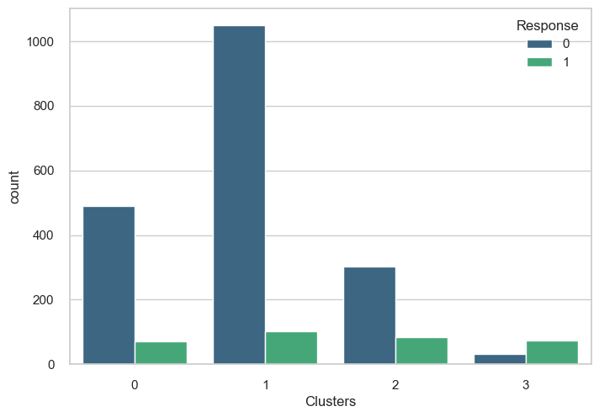
The graph determines the count of responses across each cluster.
Response No- Cluster 1 has the highest number of individuals followed by cluster 0, cluster 2 and cluster 3.
Response Yes- Cluster 1 has the maximum number of people and if we can design campaigns targeting this group, we could get a good Return On Investment.
Cluster 3 with higher income people have more response rate. So, by a few adjustments to the campaign can help others respond better.
CONCLUSION
The analysis of the marketing campaign dataset provides a detailed understanding about the customer response rates, customer segmentation, and behavior. It also provides the list of factors affecting the response rates of the customers.
The steps such as data cleaning, exploratory data analysis, feature engineering, predictive modeling, feature selection, and the model evaluation techniques help in understanding the accuracy rate of the target variable and help in determining the f1-score, and recall value for the model.
This helps in identifying the trends in the market campaign data. Accuracy scores of 87.48% & 86.72% are determined in the cases of KNN and Random Forest. To predict if the customer will respond to a campaign, the best analysis is through Random forest model.
Cluster analysis distinguishes the groups of customers across each variable thereby providing a clearer view.

Slide 19
BUSINESS INSIGHTS AND RECOMMENDATIONS
Customers with greater income show increased responses compared to the other segments of customers revealing the direct dependency of income and response.
Campaign adjustment needs to be adjusted based on the customer preferences, advancement and trends.
Family-Focused Rewards: Offer rewards and incentives that cater to the needs of families, such as family discounts, free shipping, or exclusive access to deals. Group 0 and Group 1 can be targeted using this.
Tiered Rewards: Implement a tiered loyalty program that offers additional benefits to frequent customers, encouraging repeat purchases. Group 1 has many number of people highly interested in deals. Therefore, if we can incentive wise this customer base into spending more, It would lead to the best ROI.
Targeting strategies to improve campaigning across single individuals will helps gain more response rate. Increased promotional offers will attract many groups of customers.
Demographic features and engagement- Tailored approach to customers with higher spending sector will help increase the total spending. Engaging the customers with better recommendations on the basic demographics will gain more attention.
These insights collectively help in enhancing the return of investments, and loyal customer base.

Slide 20
REFERENCES
Marketing campaign. (2020, May 8). Kaggle. https://www.kaggle.com/datasets/marketing-campaign/code
Saji, B. (2024, December 4). Elbow method for optimal cluster number in K-Means. Analytics Vidhya. https://www.analyticsvidhya.com/blog/2021/01/in-depth-intuition-of-k-means-clustering-algorithm-in-machine-learning/

